Slide 1


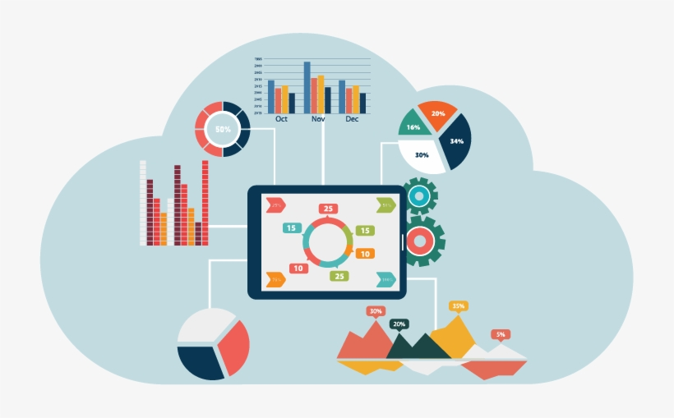
Bank Loan of Customers
Group no : 3
Group Members :
Ms. Nikita Choudhary
Mr. Umed Choudhary
Mr. Saurav Maurya
Ms. Pravitha Pavithran
Mr. Vijay Gangurde
Mr. Rwiddhiman Mallick

Slide 2
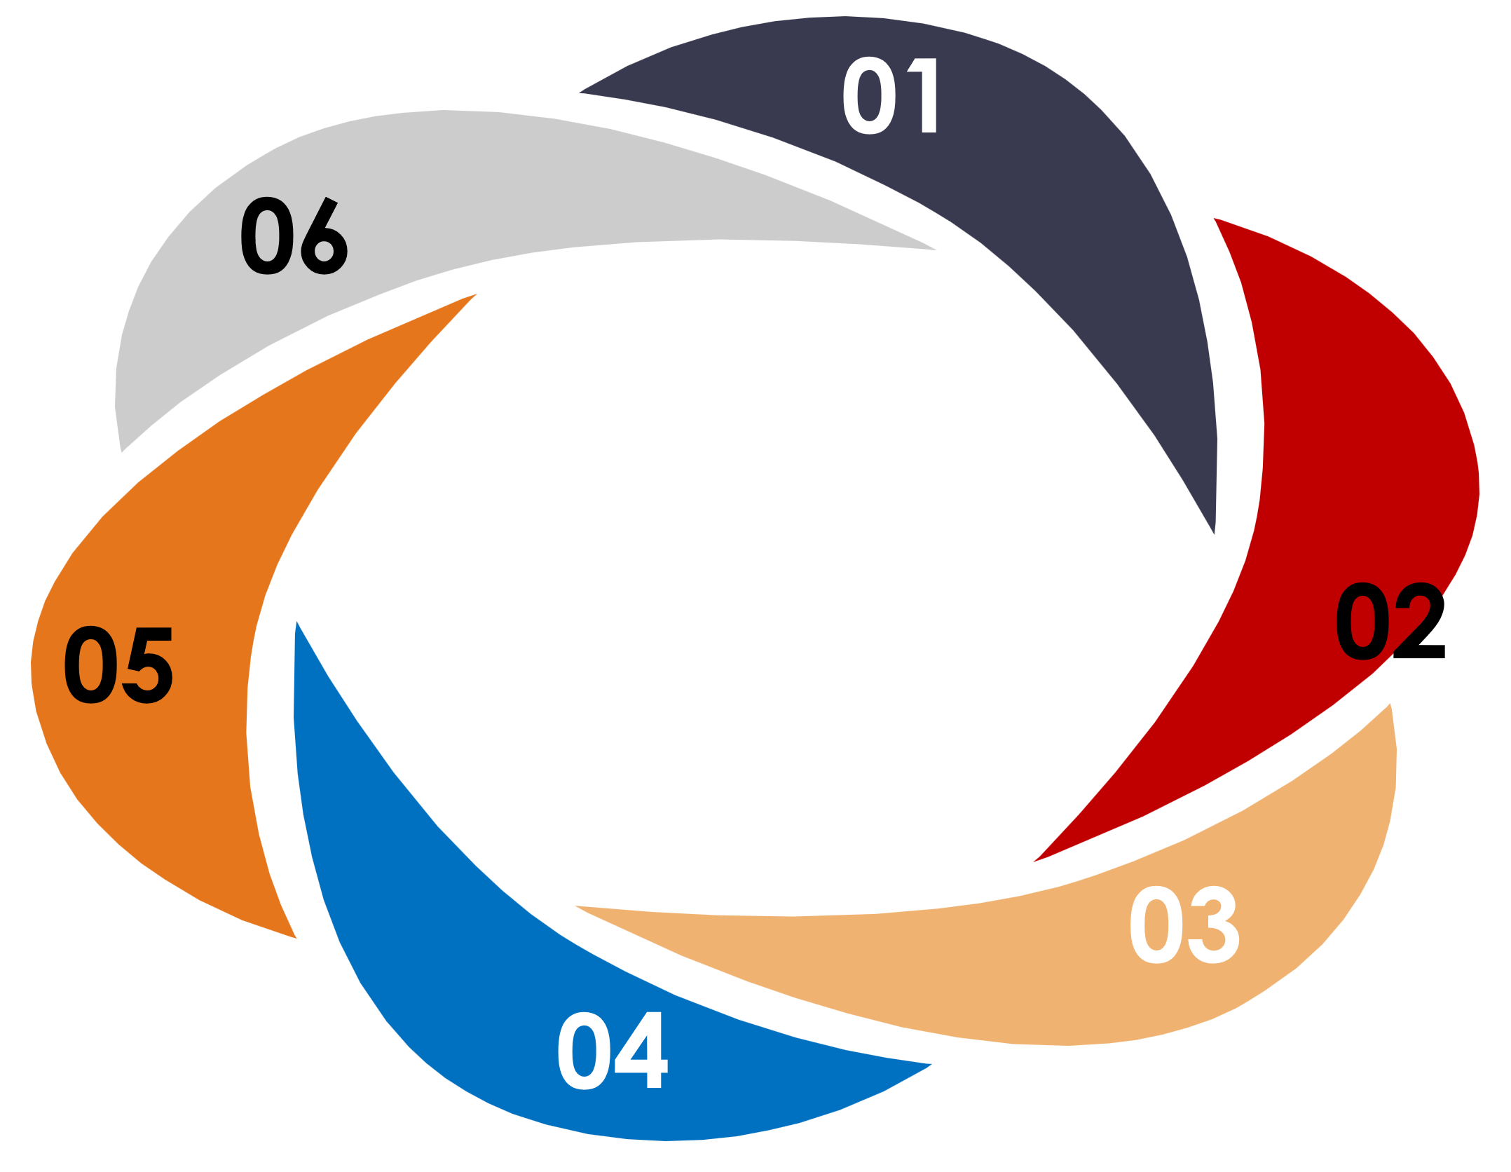

Agenda
Objective
Contents
KPI’s
Challenges Face
Conclusion
Dashboard

Slide 3
Project Objective
This is Bank loan of Customers project where we were provided with 2 datasets with .csv extension files having 39k rows each and the objective was to analyze the growth that bank got within given years in loans.
We used MS-Excel, MySQL for analyzing, cleaning and removing duplicates from dataset and prepared dashboard using Tableau and PowerBI tools where we did calculations, merging and prepared interactive dashboards.

Slide 4
Contents
KPI-1 : Year wise loan amount Stats
KPI-2 : Grade and sub grade wise revol_bal
KPI-3 : Total Payment for Verified Status Vs Total Payment for Non Verified Status
KPI-4 : State wise and last_credit_pull_d wise loan status
KPI-5 : Home ownership Vs last payment date stats

Slide 5
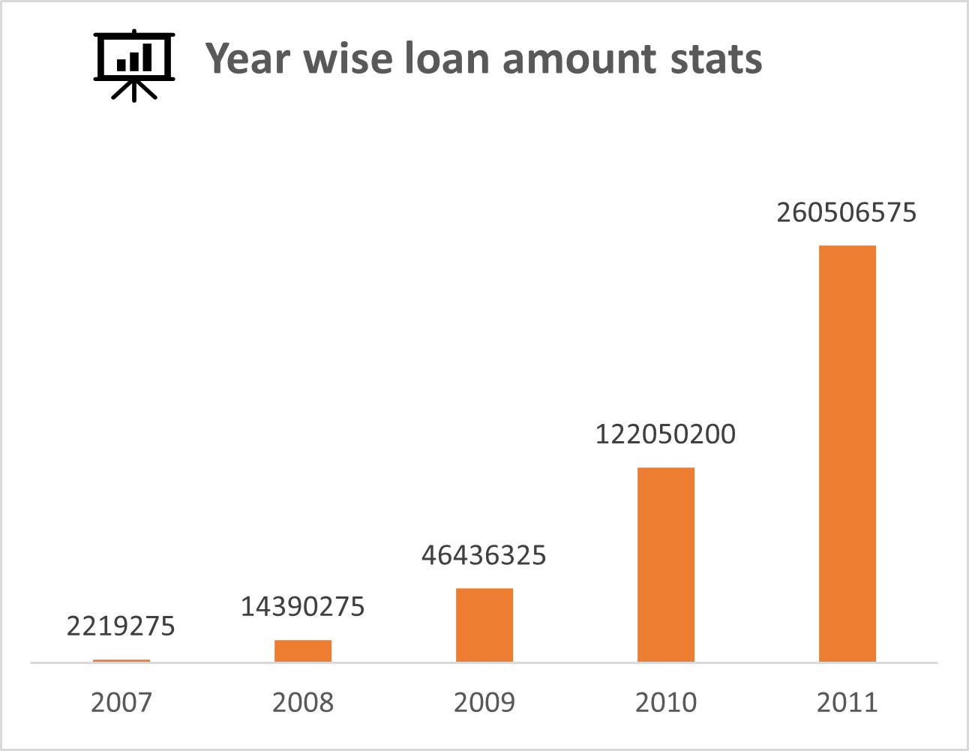
KPI-1
Year wise loan amount Stats :
The analysis of year-wise loan amounts reveals a steady increase in loan disbursements over the years, indicating a growing demand for credit among customers.

Slide 6
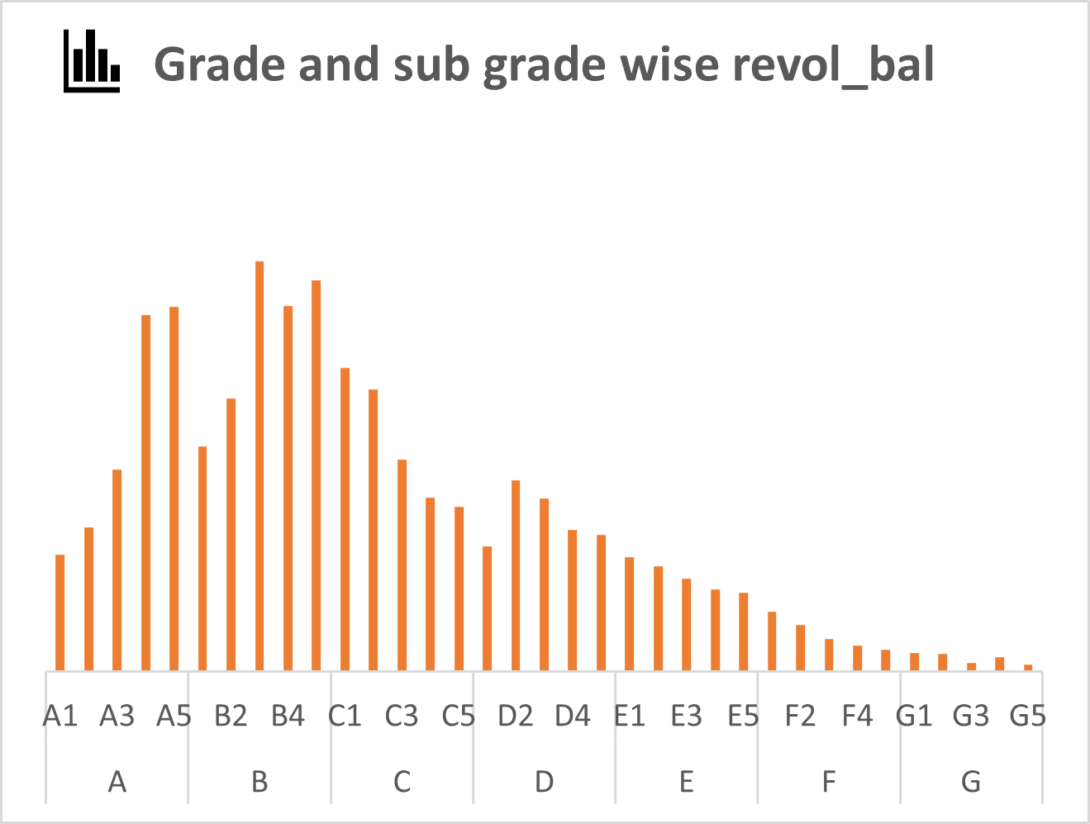
KPI-2
Grade and sub grade wise revol_bal :
Customers with higher grades and sub-grades tend to have lower average revolving balances, suggesting better credit management and lower risk of default among these segments.

Slide 7
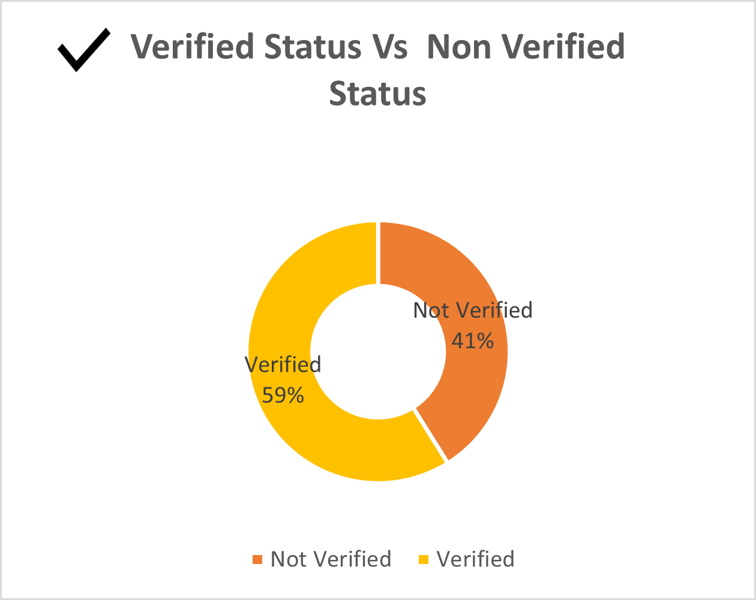
KPI-3
Total Payment for Verified Status Vs Non Verified Status :
Verified status customers generally tend to make higher total payments compared to non-verified status customers, indicating a potential correlation between verification status and financial responsibility.

Slide 8
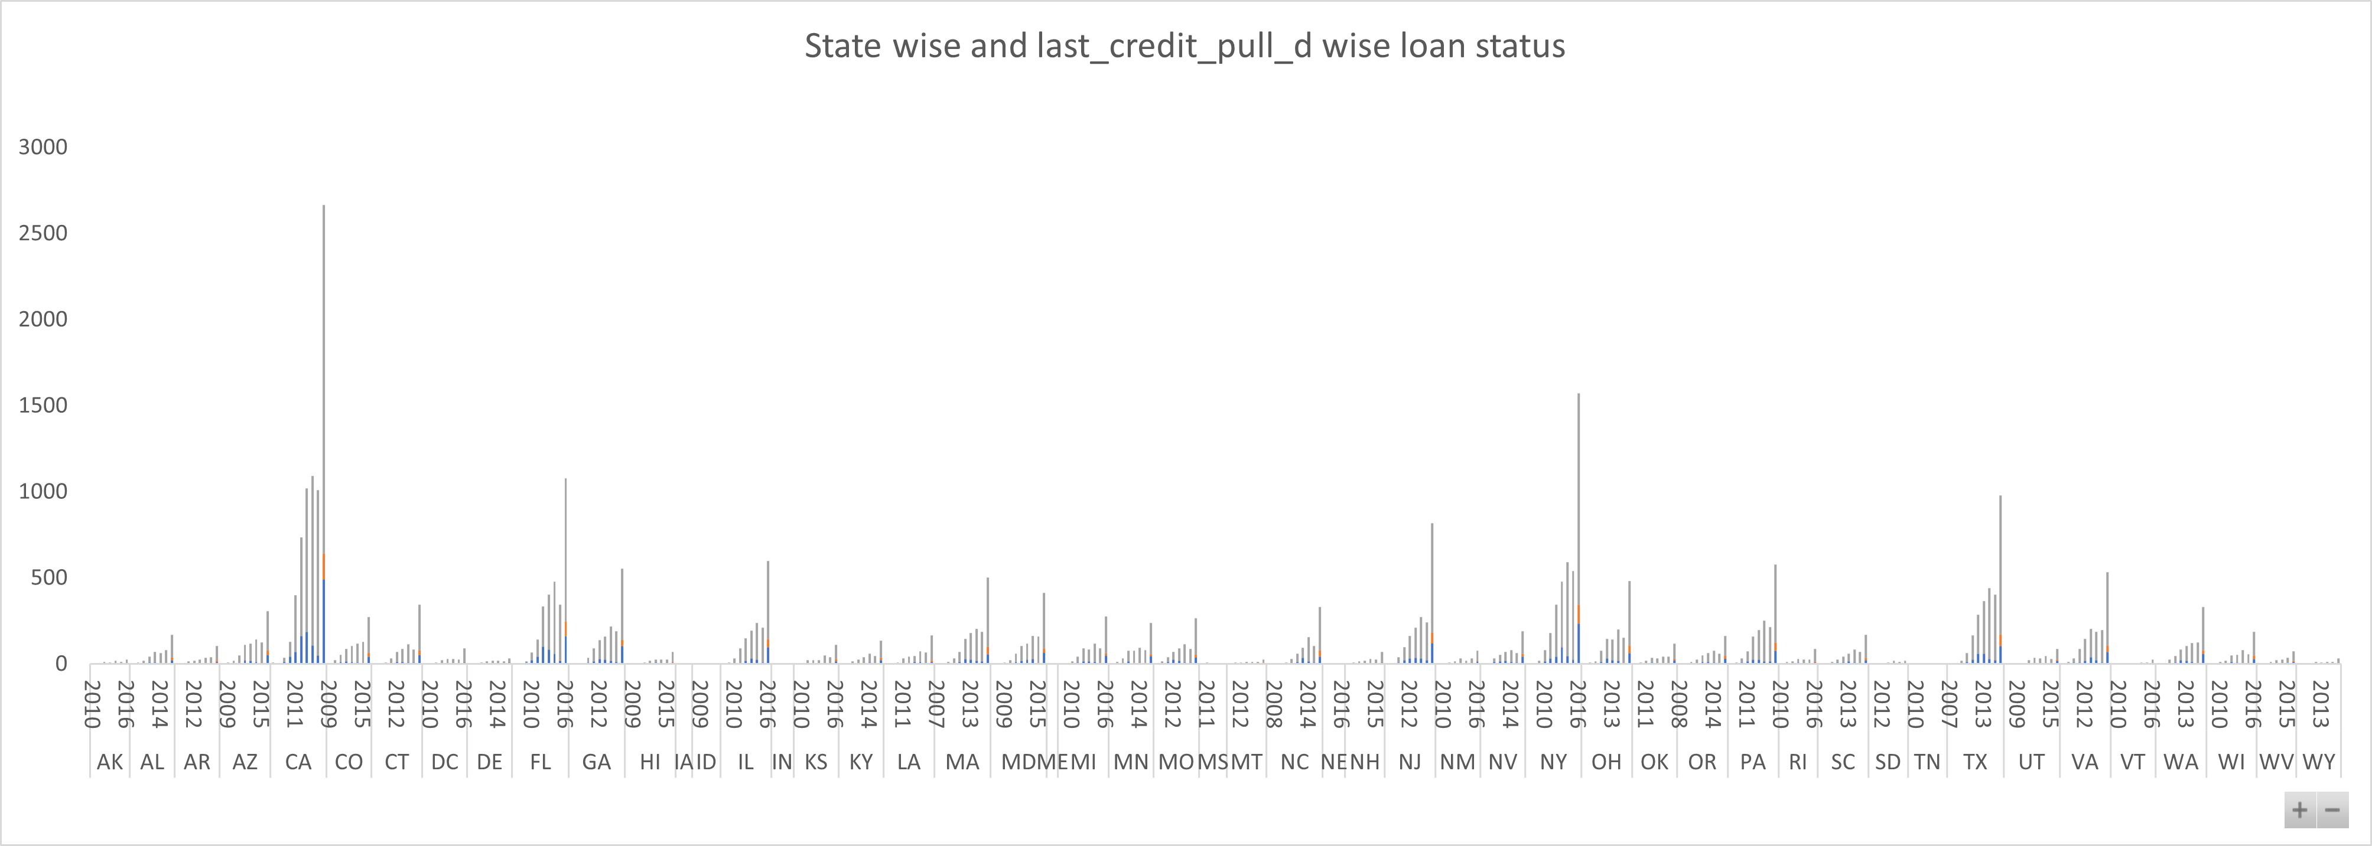
KPI-4
State wise and last_credit_pull_d wise loan status insights:
The graph above shows the all states to whom bank gave the highest amount of Loan.
As we can see CA has given highest amount of loan to customers and lowest is MA. But, maximum of customers in each state has fully paid status followed by Charged off and current.

Slide 9
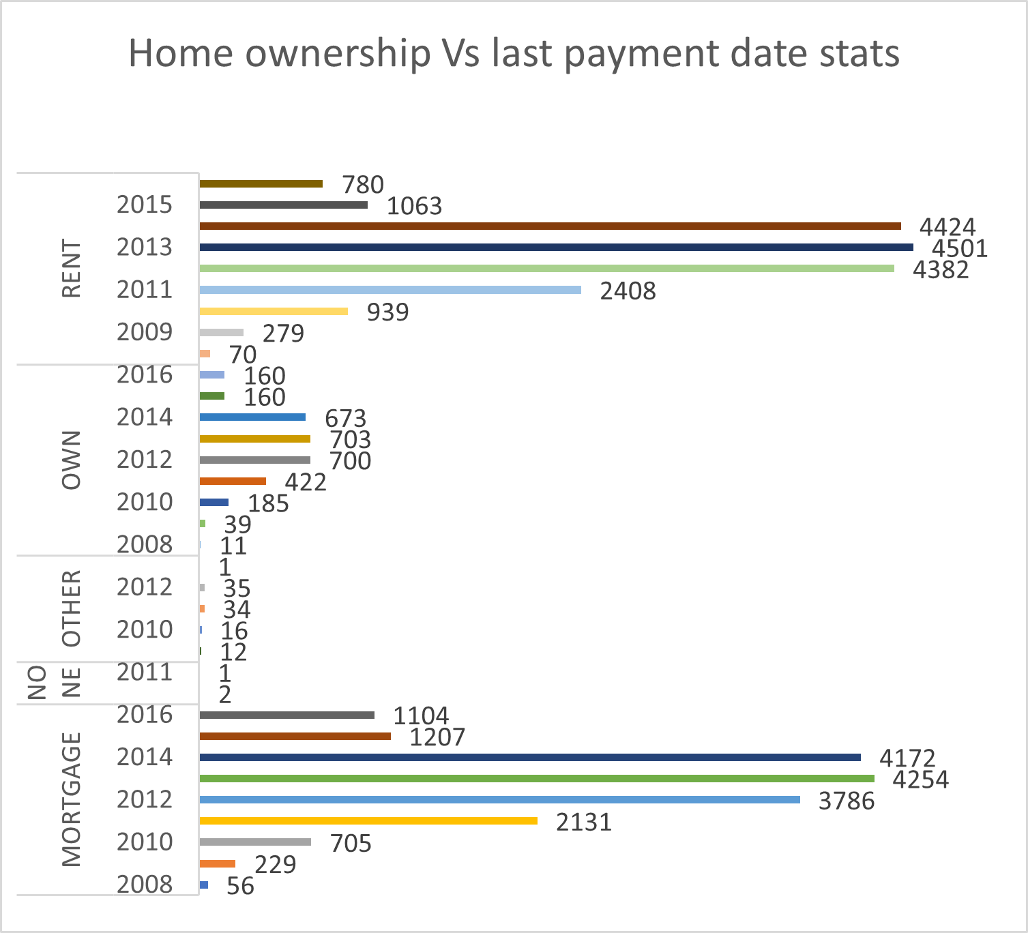
KPI-5
Home_ownership versus last payment date stats insights:
The right graph shows the Home ownership and the amount paid for each on last payment date.
Here, we can see that maximum latest amount paid by customers with MORTGAGE home ownership is Rs.17,644.
It concludes that many of the customers are about to repay their loan amount for their particular home ownership.

Slide 10
Challenges Face
Duplicate values : The dataset has underlying “duplicates” which drop through “remove duplicates” option in Power Query.
Null values : Null values were present in both datasets. Checked for Null records and replaced them with correct strings or numeric values.
Manage Relationships : For making KPIs we needed data from two tables as there was common column “id” between Finance_1 & Finance_2 dataset so we used “inner join” to join both dataset.
Blank values : While importing dataset we got an error as “1292 – incorrect date value” as there were blank values present in date column. So we gave a command set sql_mode = “” ;
Importing Files in MySQL : While importing “csv” files MySQL was throwing Error – “1290 - Secure File Priv option” as the default path for importing files was uploads folder. So changed the default path as “any location”.

Slide 11
Conclusion
The bank should continue monitoring loan disbursement trends to adjust lending practices accordingly and manage risk effectively.
Focus on verifying customer information to mitigate the risk of default, as verified status customers tend to exhibit better payment behavior.
Implement targeted strategies in regions with higher default rates to minimize credit losses and improve portfolio performance.
Tailor customer outreach and support programs based on homeownership status to encourage timely repayment and reduce delinquencies.
Further analysis could explore additional factors impacting loan performance, such as employment status, debt-to-income ratios, or credit utilization rates, to refine risk assessment models and enhance lending decisions.

Slide 12
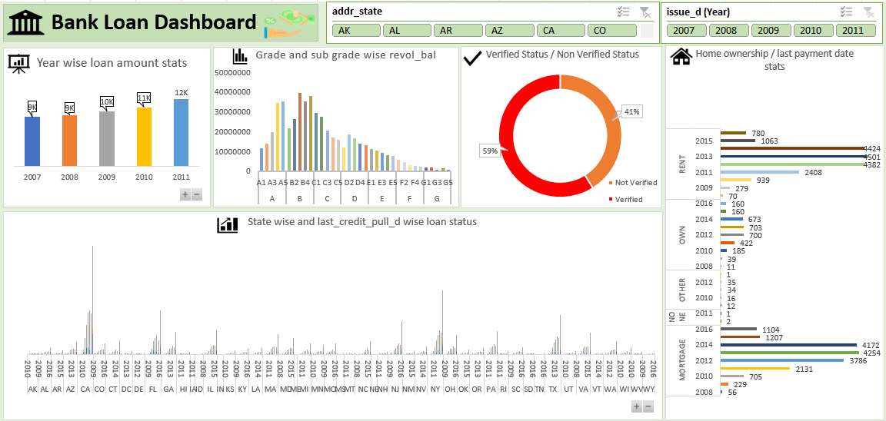
Excel Dashboard

Slide 13
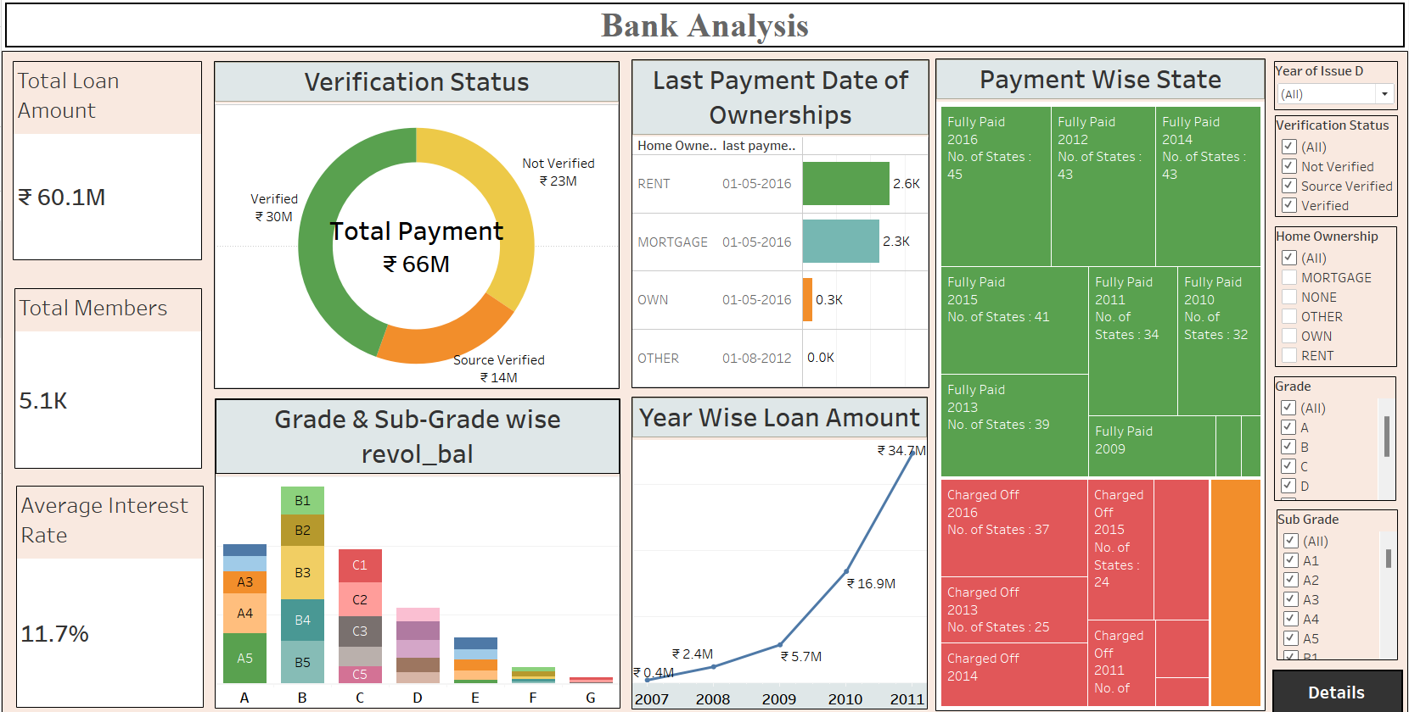
Power Bi Dashboard

Slide 14
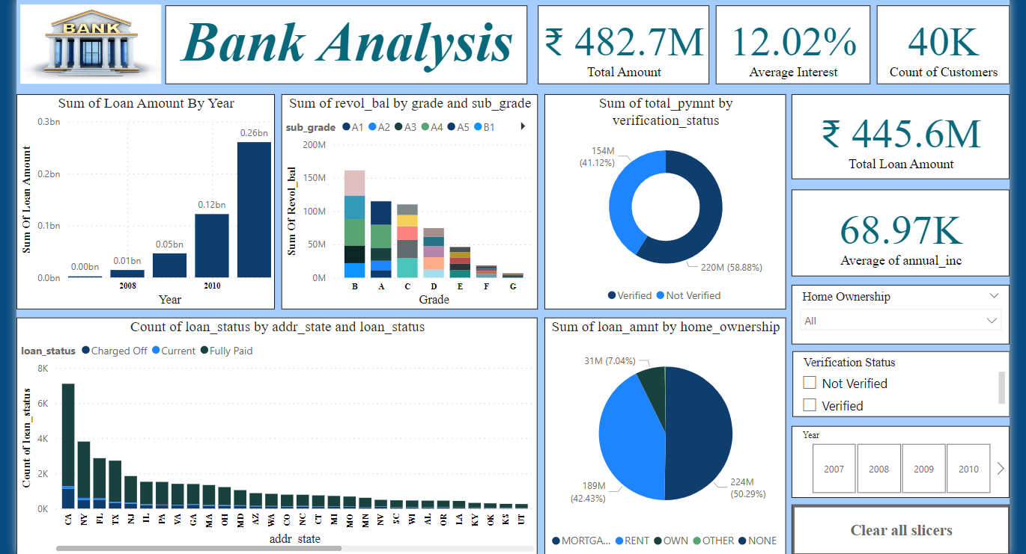
Tableau Dashboard

Slide 15
Thank You
For Your Attention

